Slide 1
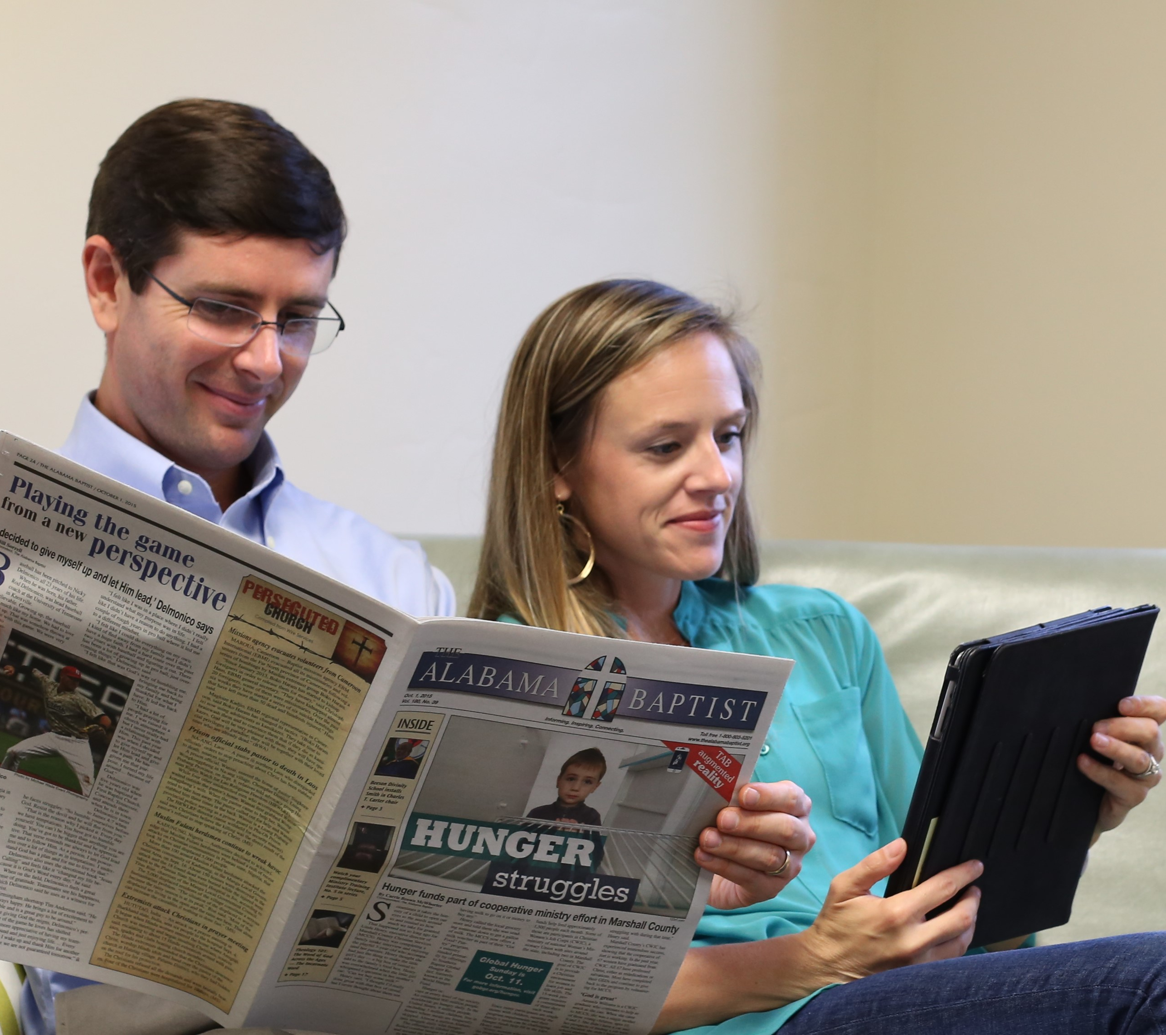
Serving Baptists for more than 175 years
• Information about real life struggles
• Inspiration for worship & discipleship
• Connection to missions & ministry
Call 1-800-803-5201

